Slide 1
What You Need to Know About Delayed Drowning
Presented by Dudley DeBosier Injury Lawyers

Slide 2
Dry drowning and secondary drowning are often used interchangeably when talking about delayed drowning, but they are two separate types of submersion injuries.

Slide 3
What is Dry Drowning?

Slide 4
Dry Drowning
After inhaling water, the vocal cords close over the windpipe to protect the lungs, making it difficult to breathe.
This is called a laryngospasm.

Slide 5
What is Secondary Drowning?

Slide 6
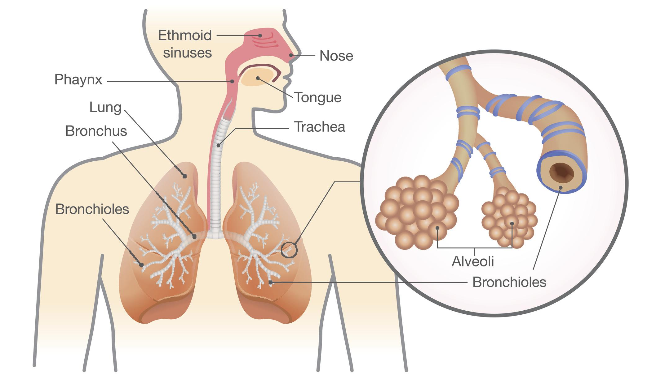
Secondary Drowning
Water gets into the lungs, causing irritation, swelling, and fluid buildup, which prevents oxygen from entering the bloodstream.
This is called pulmonary edema.

Slide 7
What Are the Symptoms of a Delayed Drowning Injury?
• Difficulty speaking and/or breathing
• Coughing
• Chest pain
• Confusion, irritability, and/or unusual behavior
• Vomiting and/or dizziness
• Low energy

Slide 8
When Do Symptoms First Appear?
Dry drowning
Secondary drowning
Within an hour
Within 24 hours

Slide 9
What to Do if You Notice Symptoms
Take your child to the emergency room immediately, rather than the pediatrician. Do your best to keep your child (and yourself) calm.

Slide 10
What to Expect When You Arrive at the Hospital
Doctors will monitor your child’s vital signs, including heart rate, body temperature, and oxygen levels.
Oxygen may be administered, and a chest x-ray may be ordered to check for fluid in the lungs.

Slide 11
Expect hospital staff to keep your child under observation for 4-6 hours.
After that, doctors will be able to determine if additional care or observation is needed.

Slide 12
The Stats
Drowning is the 2nd leading cause of death among children ages 1-4 and the 2nd leading cause of unintentional injury death among children ages 1-14*.
*Source: Centers for Disease Control and Prevention
Drowning can occur in less than one minute and in mere inches of water.
Delayed drowning is rare, occurring in less than 5 percent of near-drowning cases*. *Source: US National Library of Medicine

Slide 13
How You Can Prevent Submersion Injuries
• Always supervise your children in any amount of water, even if a lifeguard is on duty.
• Don’t depend on water wings or other floaties; do use a well-fitting U.S. Coast Guard approved life jacket.
• Keep private pools fenced off and gates closed when they’re not in use.
• Enroll your children in swim lessons as early as possible.

Slide 14
From the team at Dudley DeBosier, let’s all do our part to make our communities safer this summer.
866-641-6642
www.dudleydebosier.com

